Slide 1

Federated Learning for Wireless Communications
A Decentralized Approach to Intelligent Networks
Presented by
Muhammad Ahmed Mohsin
Muhammad Umer

Slide 2
Outline
Motivation
Federated Learning: Overview
Federated Learning & Wireless Communications
Challenges & Open Problems
Conclusion
References

Slide 3
Motivation

Slide 4

Traditional Machine Learning (Centralized)
Machine learning (ML) is the process of teaching a computer to make predictions based on the information they have been fed
Image recognition – Identifying objects in images
Speech recognition – Converting speech to text
and so much more ...
Traditionally, all data, computations, and training is done on the same device
e.g., training a simple ANN on your laptop
Problem? Not scalable

Slide 5

Distributed Learning (A step forward!)
Distributed learning encompasses a range of techniques for training algorithms across multiple machines/workers. This can involve
Parallel computing – Workers simultaneously train different parts of model
Model averaging – Efforts of workers are combined by averaging
Ensemble learning – Multiple models trained by workers are combined
Need to collect & process data in advance

Slide 6

Data Deluge – Cisco® GCI
According to seventh annual Cisco® Global Cloud Index (2016-2021), ~847 zettabytes (ZB) data will be generated at the edge while the storage capability of data centers will only reach 19.5 ZB.
Approximately 40x the estimated storage capability
Impractical, if not impossible, to transmit, collect, and process data at the data centers
Proposed Solution?
Federated Learning

Slide 7
What is Federated Learning?

Slide 8
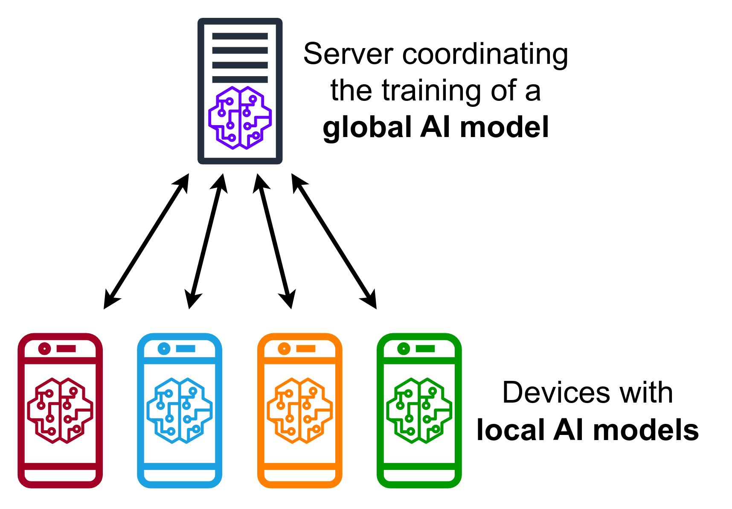
Federated Learning
In Federated Learning (FL), multiple edge devices collaboratively train a model without sharing their raw data.
Features
Scalability
Improved data diversity
Improved privacy & security
Key Differences to Distributed Learning
Central server does not control the workers
Central server can not access the raw data
Data is heterogenous (non-IID)

Slide 9
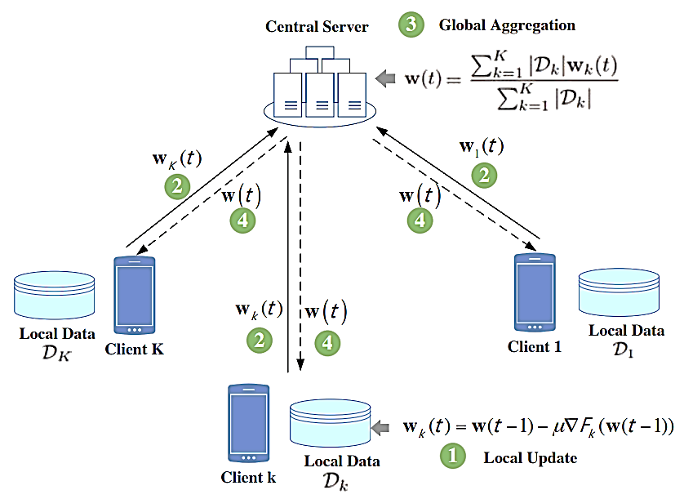
Federated Learning
Basic Principle of FL
Local Update – Each client trains the model locally with its own data, updating the model parameters w_{k}(t)
Weight Upload – Clients upload their updated model parameters w_{k}(t) to the central server
Global Aggregation – Server aggregates the received parameters from all clients, computing the average weights w(t)
Weight Feedback – Server broadcasts the updated global parameters w(t) back to all clients for the next iteration

Slide 10
Federated Learning & Wireless Communications

Slide 11
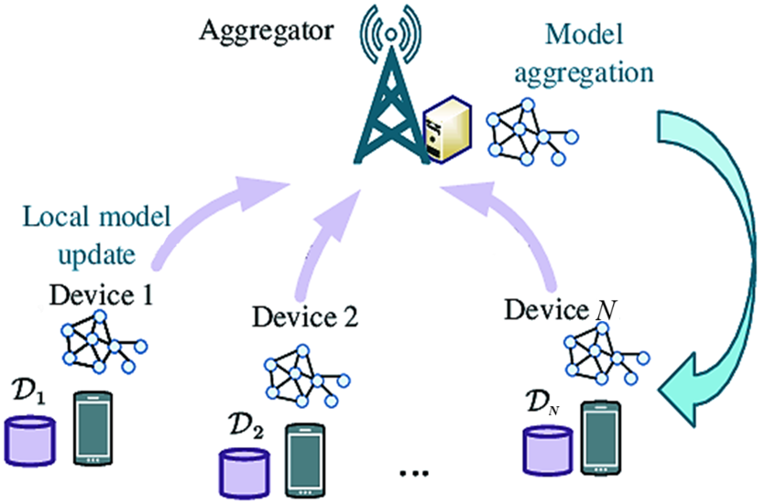
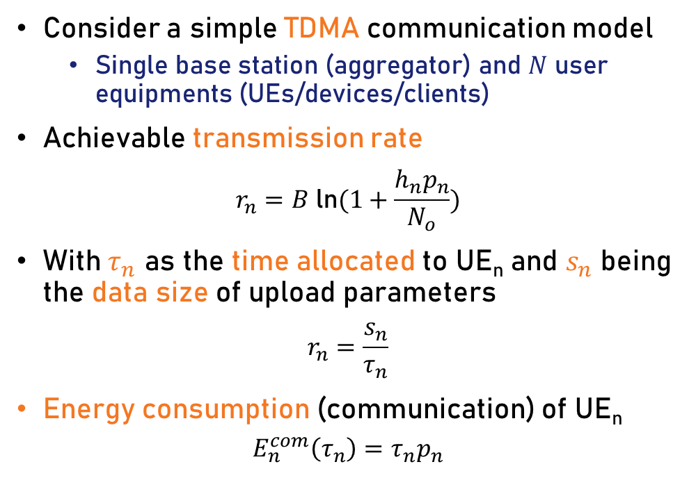
FL over Wireless Networks
Consider a simple TDMA communication model
Single base station (aggregator) and $N$ user equipments (UEs/devices/clients)
Achievable transmission rate
$$r_{n}=B \text{ln}(1+\frac{h_{n}p_{n}}{N_{o}})$$
With $τ_{n}$ as the time allocated to UE_{n} and $s_{n}$ being the data size of upload parameters
$$r_{n}=\frac{s_{n}}{τ_{n}}$$
Energy consumption (communication) of UE_{n}
$$E_{n}^{com}\left(τ_{n}\right)=τ_{n}p_{n}$$
System Model

Slide 12
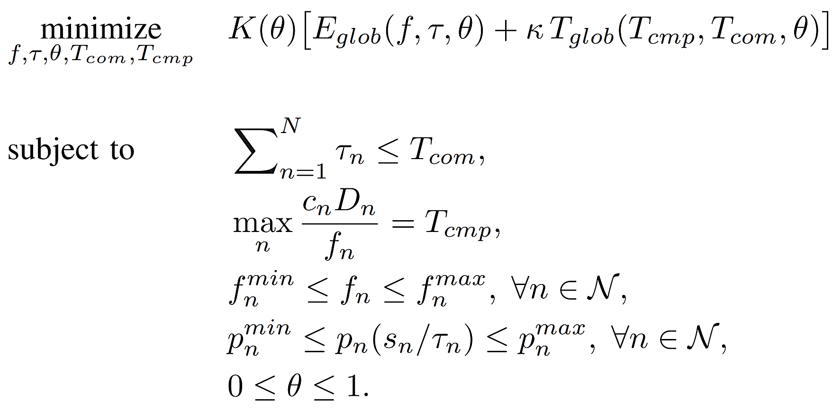

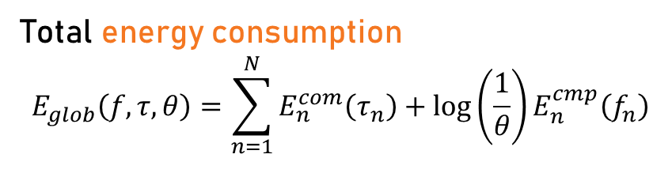
Problem Formulation
Due to Communication
Total energy consumption
$$E_{glob}\left(f,τ,θ\right)=\sum_{n=1}^{N}{E_{n}^{com}\left(τ_{n}\right)}+\text{log}\left(\frac{1}{θ}\right)E_{n}^{cmp}\left(f_{n}\right)$$
Total learning time
$$T_{glob}(T_{com},T_{cmp},θ)$$
Due to Computation
...
Alternating Optimization
Time sharing constraint of TDMA
Successive Convex Approximation
Dynamic Programming
UE bottleneck
Non-convex Problem
CPU frequency
...
...
Deep Reinforcement Learning
BS power range
Local accuracy

Slide 13
FL & Wireless Networks (Popular than ever)
Incentive Mechanism for FL in Wireless Networks
Le, Tra Huong Thi, et al. "An incentive mechanism for federated learning in wireless cellular networks: An auction approach." IEEE Transactions on Wireless Communications
FL over Cell-free Massive MIMO
Vu, Tung Thanh, et al. "Cell-free massive MIMO for wireless federated learning." IEEE Transactions on Wireless Communications
FL in RIS-aided Systems
Ni, Wanli, et al. "Federated learning in multi-RIS-aided systems." IEEE Internet of Things Journal
FL in UAV-aided Systems
Brik, Bouziane, Adlen Ksentini, and Maha Bouaziz. "Federated learning for UAVs-enabled wireless networks: Use cases, challenges, and open problems." IEEE Access

Slide 14
Challenges & Open Problems
Federated Learning is still in its infancy!

Slide 15
Challenges & Open Problems
[ Directions ]
Communication Overhead – Frequent communication of model updates consumes bandwidth and energy
Heterogeneity – Devices have diverse data and computational capabilities, leading to uneven model contributions
Privacy Leakage – Sharing local model updates can expose private user information^{[1]} and compromise security
Resource Constraints – Limited battery life and computational resources on edge devices restrict training capabilities
Ensure minimal data transfer
Develop algos. to ensure user fairness
Guarantee data privacy and model security
On-edge quantization & compression
[1] D. Enthoven, Z. A. Ars. (2021). Fidel: Reconstructing Private Training Samples from Weight Updates in Federated Learning.

Slide 16
Conclusion

Slide 17
Conclusion
Federated learning paves the way to intelligent wireless networks by enabling collaborative learning
Federated learning has the potential to revolutionize wireless communications by personalizing network parameters and resource allocation based on individual device behavior
While significant challenges remain, ongoing research and development efforts are paving the way for widespread adoption of FL in next-generation wireless networks

Slide 18
References
Tran, N. H., Bao, W., Zomaya, A., Nguyen, M. N., & Hong, C. S. (2019, April). Federated learning over wireless networks: Optimization model design and analysis. In IEEE INFOCOM 2019-IEEE conference on computer communications (pp. 1387-1395). IEEE.
Yang, Z., Chen, M., Wong, K. K., Poor, H. V., & Cui, S. (2022). Federated learning for 6G: Applications, challenges, and opportunities. Engineering, 8, 33-41.
Niknam, S., Dhillon, H. S., & Reed, J. H. (2020). Federated learning for wireless communications: Motivation, opportunities, and challenges. IEEE Communications Magazine, 58(6), 46-51.
Qin, Z., Li, G. Y., & Ye, H. (2021). Federated learning and wireless communications. IEEE Wireless Communications, 28(5), 134-140.

Slide 19
Thank You
Any Questions?

